Slide 1
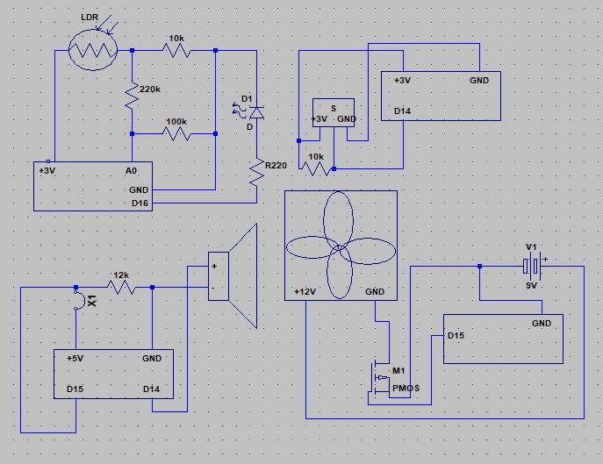
Smarthome
Pekka Rajala, Aki Seppänen, Eemeli Tikka
Information Technology, Equipment and Product Design
Communications Application Project
ECTS credits: 6
Date of publication: 2018, Winter
Instructors: Kari Jyrkkä, Jukka Jauhiainen, Jaakko Kaski, Kaija Posio

